Slide 1
Farm to Home
Avishkarna Andhra Internship Mini Project
A full-stack e-commerce web application connecting local farmers directly with consumers.

Slide 2
Problem Statement & Objective
The Problem: Farmers often struggle with middlemen reducing their profits, while consumers face a lack of transparency and direct access to high-quality, fresh agricultural produce.
The Objective: To develop a direct-to-consumer digital marketplace that eliminates middlemen, ensures fair pricing for farmers, and provides consumers with an easy way to purchase fresh, organic produce straight from the source.
2

Slide 3
App Features: Consumer (Buyer)
Smart Marketplace: Browse, filter, and search for fresh produce by category.
FarmPass Subscriptions: Premium membership for zero delivery fees and exclusive discounts.
Real-Time Direct Chat: Communicate directly with farmers about produce freshness via Socket.io.
Dynamic Checkout: Multi-step checkout with real-time cart subtotal and delivery calculations.
3

Slide 4
App Features: Farmer (Seller)
Dedicated Dashboard: High-level overview of total earnings, pending orders, and product count.
Inventory Management: Full CRUD capabilities to manage products, pricing, and stock.
Order Processing System: Seamlessly update order fulfillment status (Pending → Processing → Delivered).
Profile Management: Build trust by maintaining a public profile showcasing farming practices.
4

Slide 5
Tech Stack & Architecture
Frontend: React.js & Vite with responsive, Mobile-First Custom Vanilla CSS.
Backend: Node.js & Express.js (RESTful APIs).
Database: MongoDB & Mongoose.
Authentication: JSON Web Tokens (JWT) with strict Role-Based Access Control (RBAC).
Real-Time & Cloud: Socket.io for live chat and Cloudinary for secure, scalable image uploads.
5

Slide 6
Methodology / How We Built It
1
2
Phase 1 (Design)
Phase 2 (Backend)
Created the UI/UX with a mobile-first approach and designed the MongoDB schemas for Users, Products, and Orders.
Developed secure RESTful APIs, set up JWT-based dual-role authentication, and configured Cloudinary for media.
3
4
Phase 3 (Frontend)
Phase 4 (Advanced Integration)
Built responsive React components, integrated state management, and connected to backend endpoints.
Deployed WebSocket (Socket.io) for real-time messaging and implemented the dynamic FarmPass subscription logic.
6

Slide 7
Challenges & Future Scope
Challenges Faced
Future Scope
Strict Dual-Role Access Control and routing (Farmer vs Consumer).
Managing real-time WebSocket state connections cleanly on the frontend.
Designing a highly responsive UI without relying on heavy CSS frameworks.
Integration of external payment gateways (Stripe/Razorpay).
AI-driven price prediction and demand forecasting.
Logistics and third-party delivery partner integration.
7

Slide 8
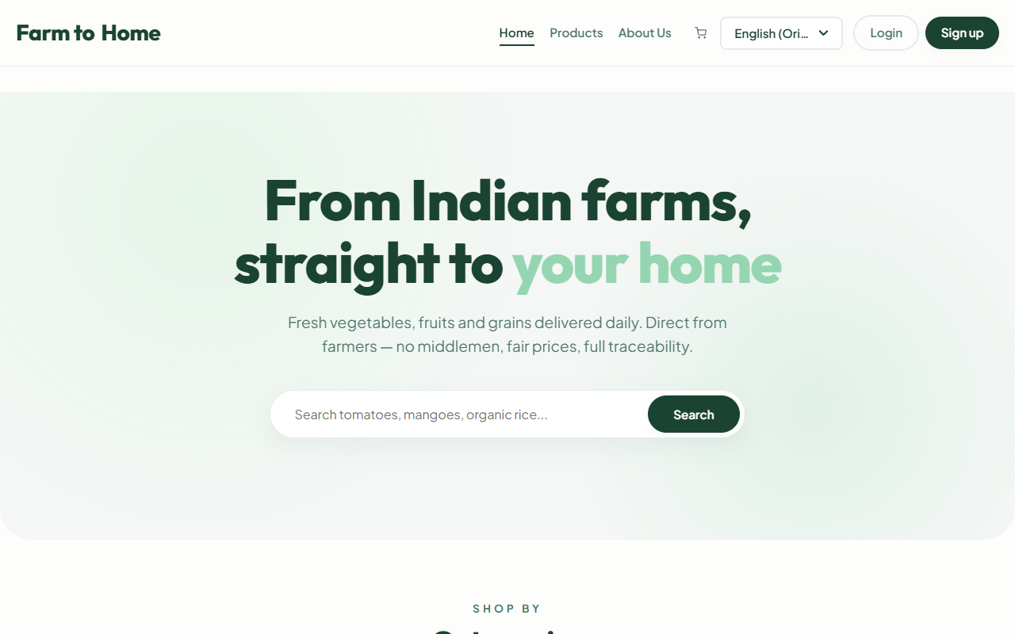
1. Home Page
Explanation: The welcoming storefront featuring a modern hero-banner. Highlights the core value proposition and displays featured products to immediately engage users.
8

Slide 9
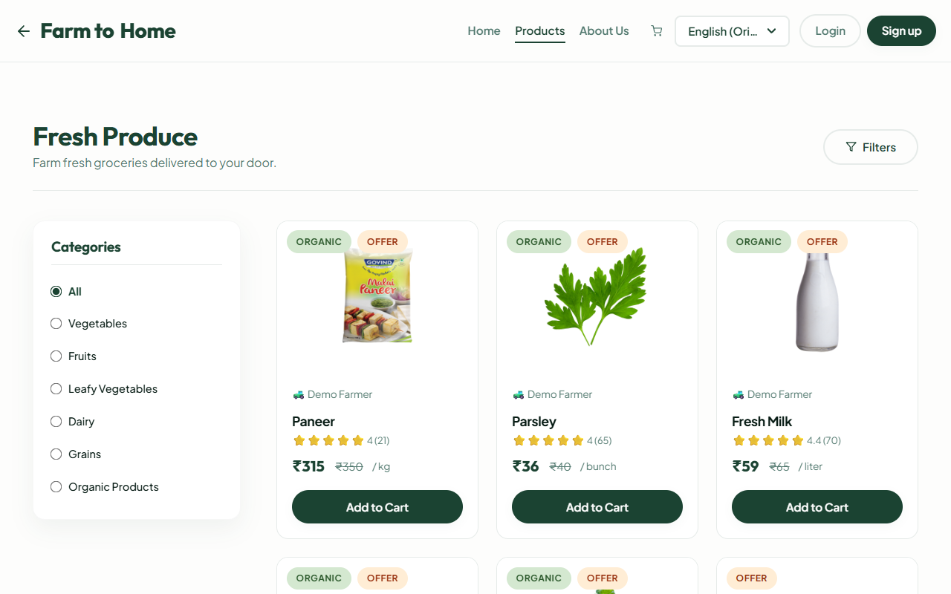
2. Products Marketplace
Explanation: The primary shopping interface for consumers. Presents a responsive grid layout of fresh produce with filtering by category and search functionality.
9

Slide 10
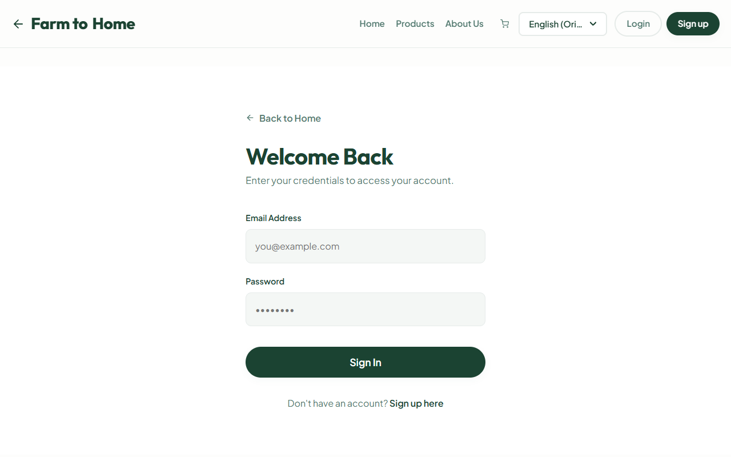
3. Secure Authentication
Explanation: A dual-role authentication portal where users specify if they are a "Consumer" or "Farmer". Powered by JWT token encryption ensuring data security.
10

Slide 11
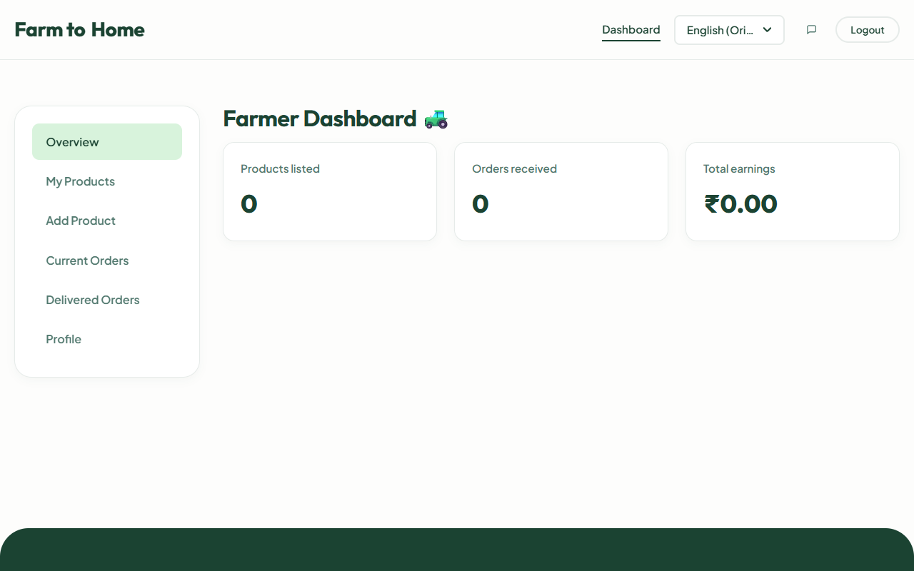
4. Farmer Dashboard
Explanation: A secure management panel for verified farmers to track earnings, fulfill orders, and seamlessly manage product inventory.
11

Slide 12
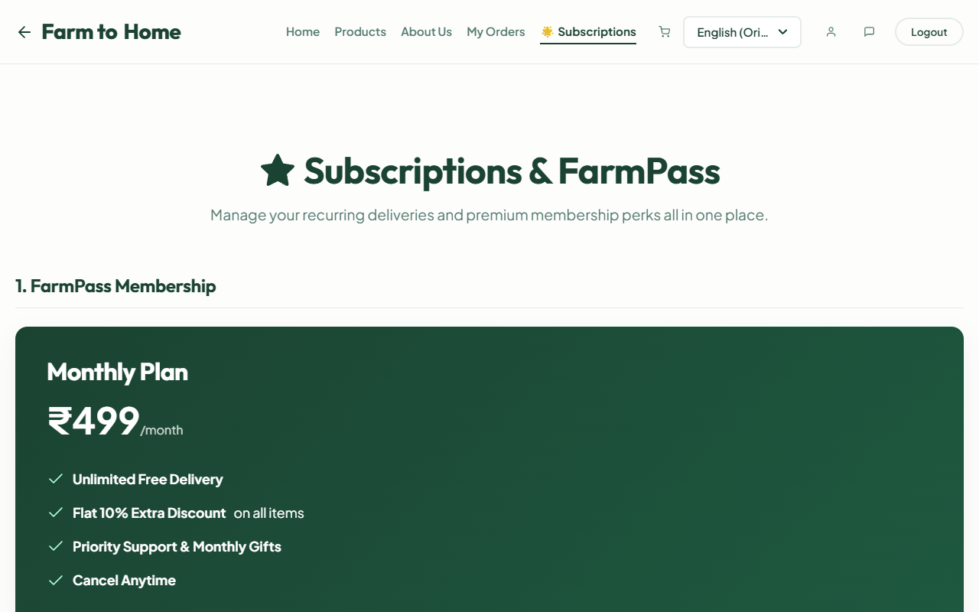
5. FarmPass & Subscriptions
Explanation: A dedicated section allowing users to manage premium features like FarmPass for zero delivery fees and recurring essential deliveries.
12

Slide 13
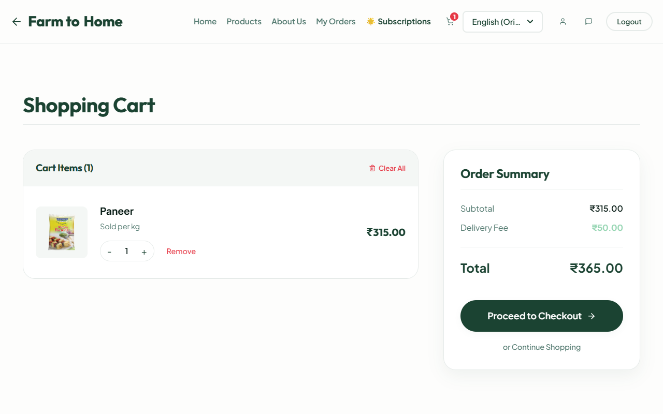
6. Dynamic Cart & Checkout
Explanation: A seamless shopping cart that automatically calculates subtotals, applies FarmPass discounts, and computes delivery fees before checkout.
13

Slide 14
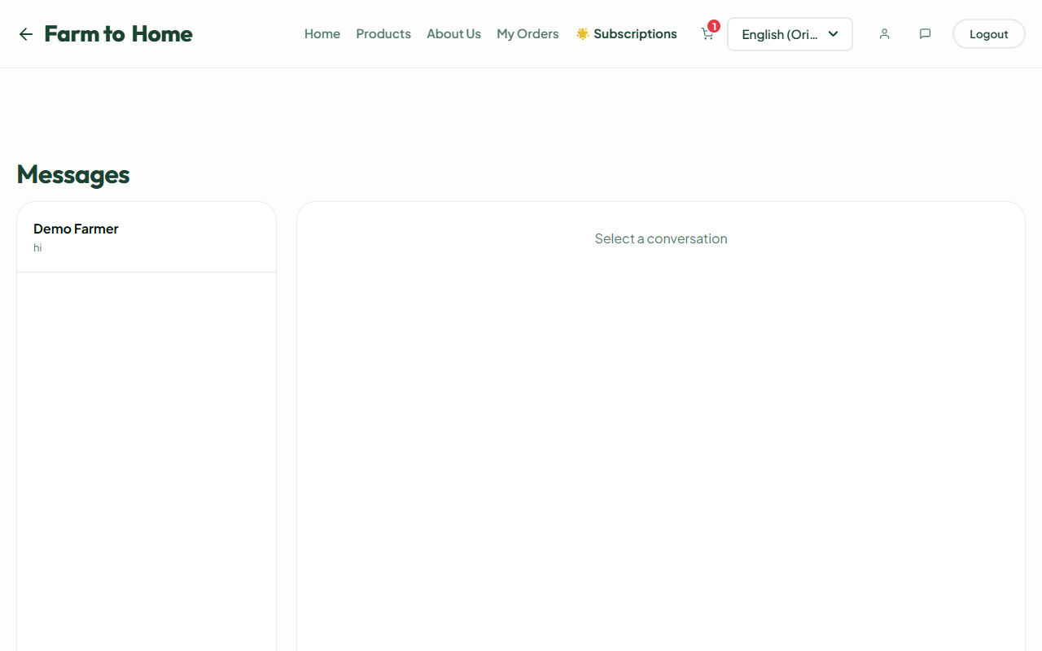
7. Real-Time Chat
Explanation: A Socket.io-powered messaging system enabling direct communication between consumers and farmers to ask about product freshness or delivery.
14

Slide 15
Thank You!
Any Questions?

